Slide 1
Enhancing Road Safety through Data Analysis: A Case Study of Traffic Crashes Resulting in Injury
INFS-580-001 | Prof. Dr. Paul Smith
Ashrith Bhooka Ravinandan
George Mason University
Fairfax, Virginia
abhookar@gmu.edu

Slide 2
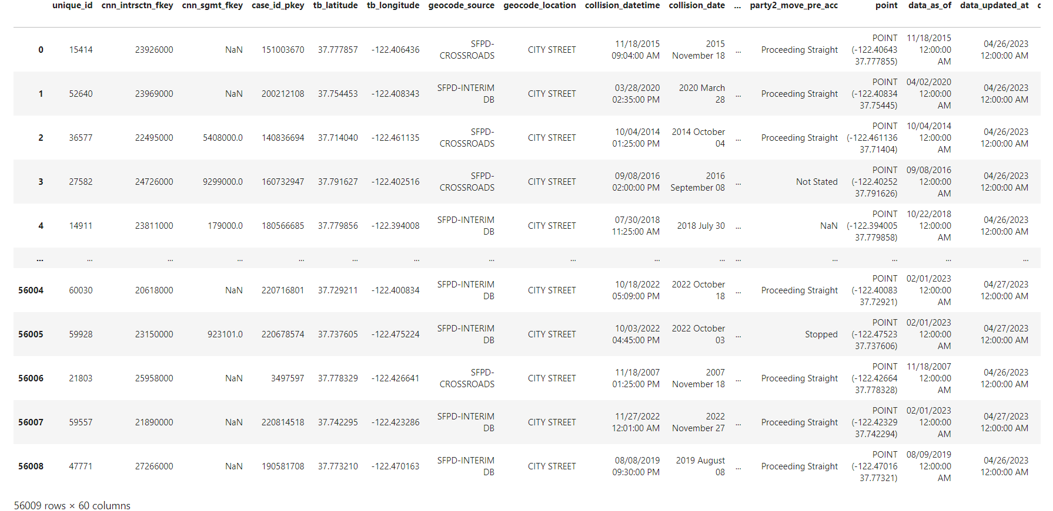
Dataset
I selected Traffic Crashes Resulting in Injury

Slide 3
Research Questions
What are the most common weather conditions associated with traffic crashes resulting in injury?
Are there specific days of the week or times of the day when these accidents are more likely to occur?
Do certain intersections or road types have a higher frequency of injury-related accidents

Slide 4
Methodology
First I used python for cleaning the dataset.
Used SQL queries for Statistical Analysis.
Leveraged R for data visualizations.
Applied Natural Language Processing techniques for weather condition analysis.

Slide 5
Key Findings
Clear skies were the most common weather condition in injury-related crashes.
Wednesdays and late afternoons saw the highest frequencies of accidents.
Top locations with higher frequencies were 'Midblock > 20Ft' and 'Dry' road conditions.
Built a linear regression model to understand the relationship between collision severity and the number of injuries.

Slide 6
Lessons learned from the project
Importance of a multifaceted approach using Python, R, Sql, and NLP.
Realizing the significance of real-world implications.
Understanding that traffic safety insights impact policies, interventions, and public well-being.

Slide 7
Thank You

